Slide 1
Transport Management System
CMIS 3122 –Rapid Application Development
Group No- 04
  Presenters………
  S.D.T.C.R.Wijerathne (152063)
  A.P.M.W.Arachchi (152004)

Slide 2
Introduction
Designed for “Chamod Transport Service”,a company that handles container transportation from harbor to islandwide locations.
Uses java as the programming language for front end development.
Uses MySQL for back end development.

Slide 3
Project Aims
Fully automated Order Handling
Providing financial status
Managing truck maintenance
Handling 3rd party requests
Automating driver salary calculations

Slide 4
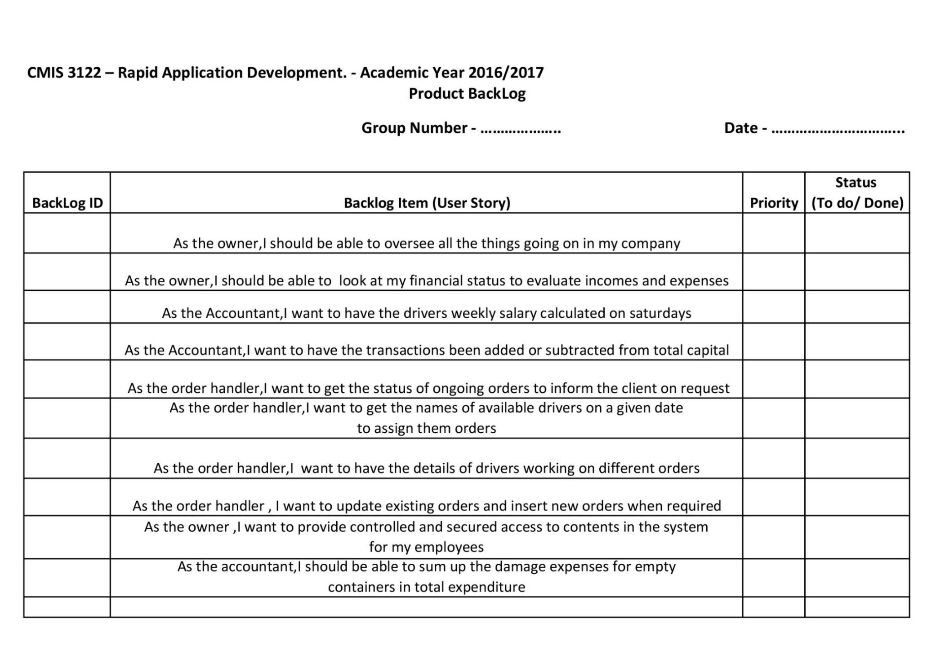
Back Log

Slide 5
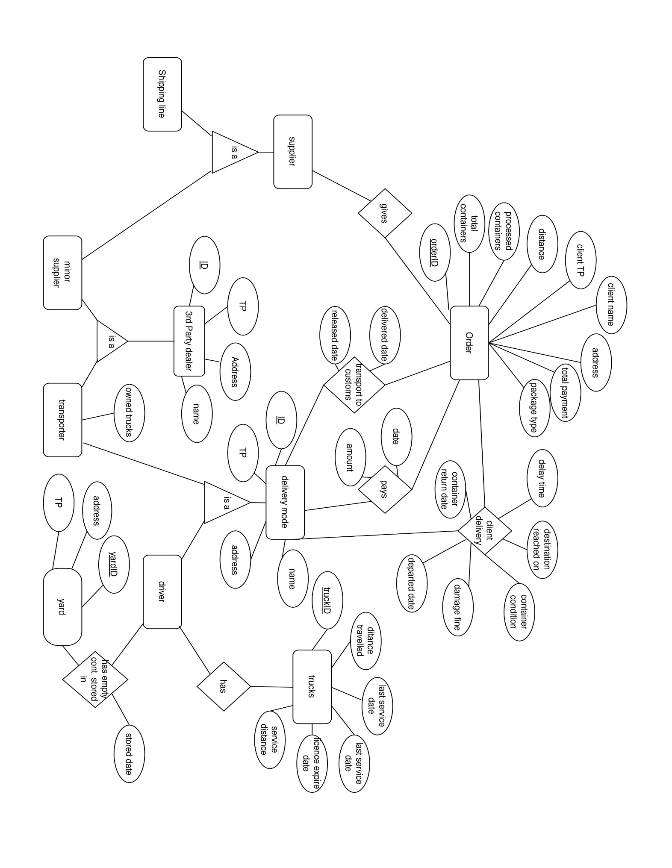
ER Diagram

Slide 6
HOW THE PROCESS WORKS

Slide 7
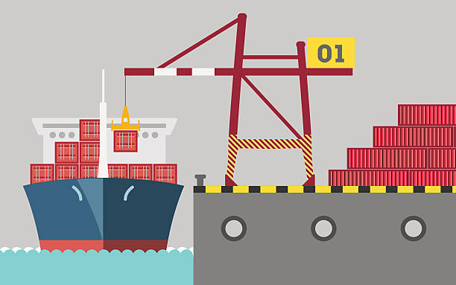
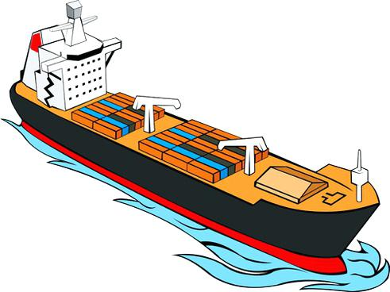

SHIPPING LINE:
takes Unloading containers
MAIN SHIPPING COMPANIES
Our main client:
SHIPPING LINE COMPANY

Slide 8
Now, the shipping line wants to deliver the goods in containers and
Get the empty containers back to return to main shipping companies
But, THE SHIPPING LINE DOESN’T OWN TRUCKS FOR TRANSPORTATION
That’s where we(our client) comes in;
THE TRANSPORT SERVICE

Slide 9
Container transportation by the TRANSPORT SERVICE (our client) can be divided into three stages, container transportation from ;
Harbour to customs
Customs to the destination
Destination to the shipping lies yards

Slide 10
The transport service has drivers and trucks(which are owned by the company)
That are used to transport the containers

Slide 11
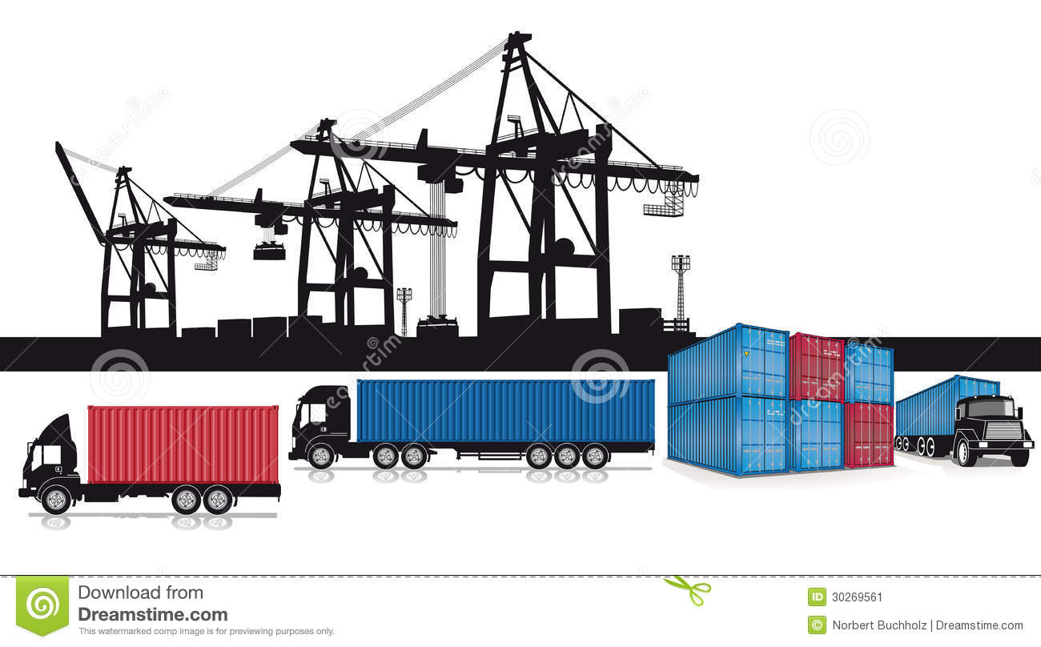
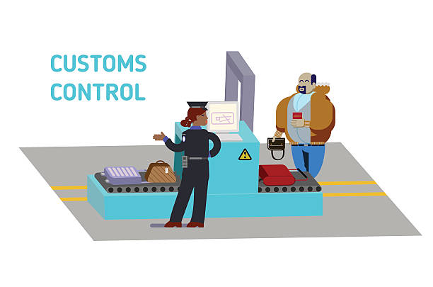
STAGE 1
harbor
to
customs

Slide 12
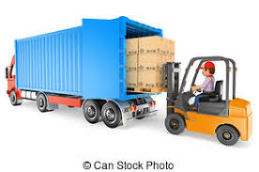
STAGE 2
customs
to
destinations
Where we unload the goods

Slide 13
BUT
THEIR MAY BE UNLOADING DELAYS.
Our client consider a TRUCK as HELD UP if the time to unload at destination exceeds 24 hours from the time they reached the location

Slide 14
HELD UP
OUR CLIENT CHARGES FOR EXTRA DAYS WHILE IN HELD UP

Slide 15
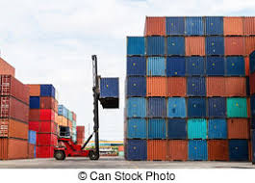
STAGE 3
EMPTY CONTAINER RETURN
DESTINATION
to
SHIPPING LINE’S YARD
Where we unload the empty containers

Slide 16
A DRIVER WILL BE PAID FOR EACH TRIP HE MAKES TO DELIVER A CONTAINER
THE DRIVERS SALARY WILL BE PAID WEEKELY

Slide 17
Peer Transporters
Like our client there are other companies that provide the same service(container transportation)
When our client gets a large order some of the containers are given to the peer transporters for efficient delivery (OUTSOURCE)
Peer transporters does the same when they get large orders.(3rd party orders)

Slide 18
Completed Works
Insertion and editing of :
-Drivers
-Trucks
-Transporters
-Shipping Lines
Assigning and removing of trucks from drivers
Adding a new order and executing all its stages
Handling 3rd party orders and outsourcing
Viewing Orders ( with filtering)
Alerts on trucks requiring maintainance

Slide 19
Thank You

